Slide 1
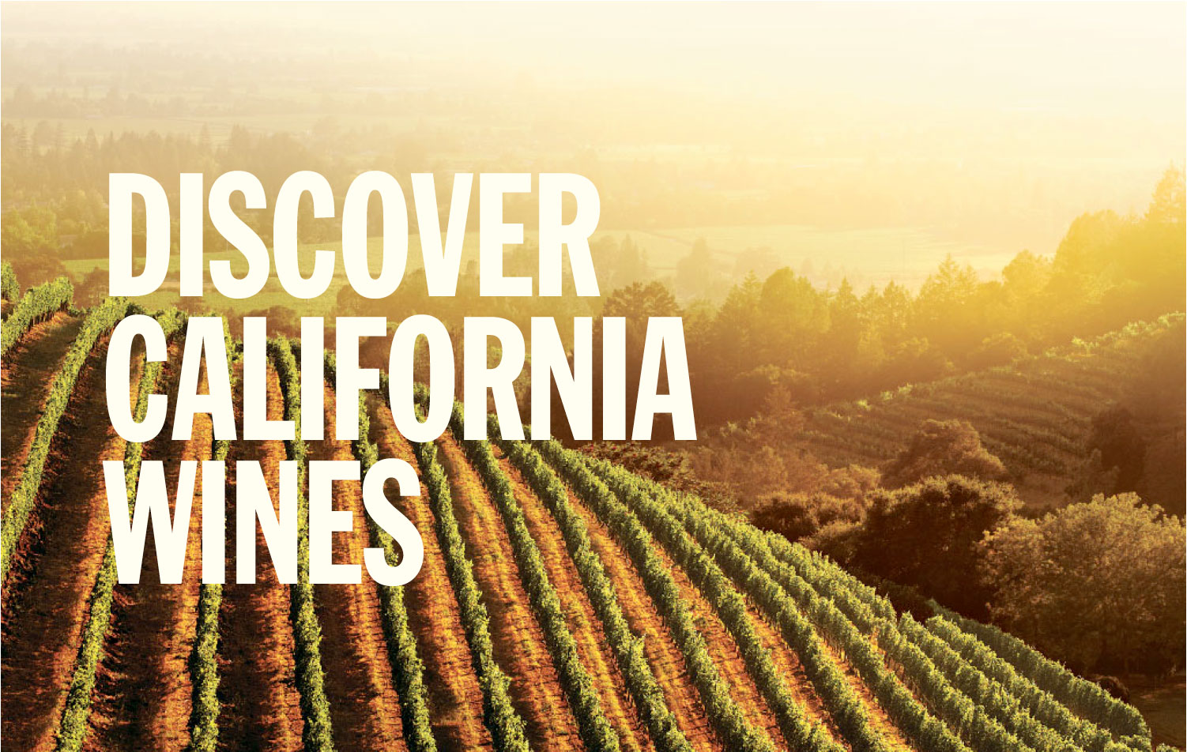
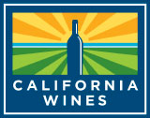
TM
/ PRESENTED BY JANE DOE, Wine Institute Director of International Marketing
May 2017
Notes:
Thank you for being here and welcome to “Discover California Wines”
(INTRODUCE YOURSELF, INCLUDING YOUR TITLE AND YOUR ORGANIZATION NAME)
We represent Wine Institute of California, the non-profit trade association of 1,000 California wineries dedicated to the responsible production, promotion and protection of California wines.
California is America’s top wine producer, accounting for 85 percent of U.S. wine. It is the fourth leading wine producer in the world.
During this presentation, I will share with you information on climate, soils, geography, history, the diverse winegrowing regions, sustainability, food & wine, and examples of attributes which make California unique in the world of wine.
Thank you for your attention and enjoy!

Slide 2
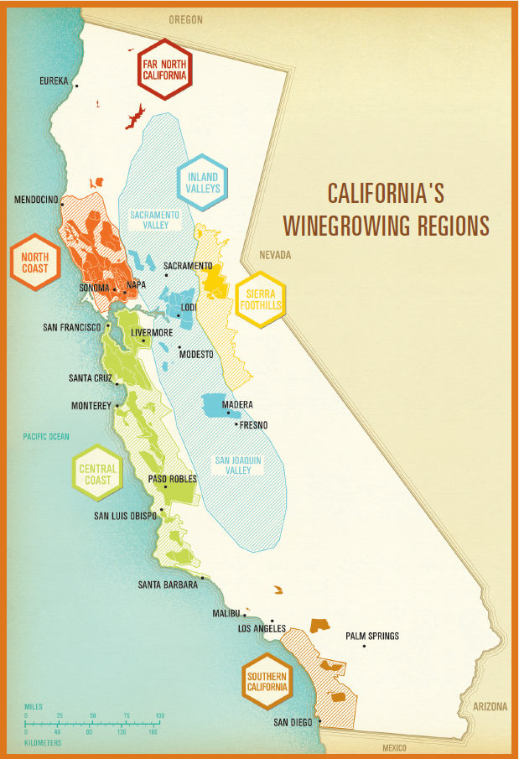
/ GOLDEN STATE GEOGRAPHY
800 miles (1,300 km) of coastline
Cool ocean air is drawn inland to warmer valleys, creating California’s famous coastal fog
Marine breezes and fog create the ideal combination of warm days and cool nights in California vineyards
DiscoverCaliforniaWines.com
Notes:
The long California coastline and the influence of the Pacific Ocean create the conditions for producing high quality grapes and wine
California has 800 miles (1,300 km) of coastline – one of the longest coastlines in the world adjacent to a winegrowing region.
Cool ocean air is drawn inland to warmer valleys creating California’s famous coastal fog.
Marine breezes and fog create the ideal combination of warm days and cool nights for growing grapes.
The marine influence extends California’s growing season to allow deeper color, flavor and optimum maturity.

Slide 3
Click to play animation
DiscoverCaliforniaWines.com
Notes:
Here is a satellite animation of California’s coast.
It demonstrates how the ocean air is drawn along the coast, influencing all of our winegrowing regions.
The ocean breezes are drawn far east towards the mountains, cooling our inland valleys and regions such as Sacramento and Lodi.
**(Play animation in slide above)**

Slide 4
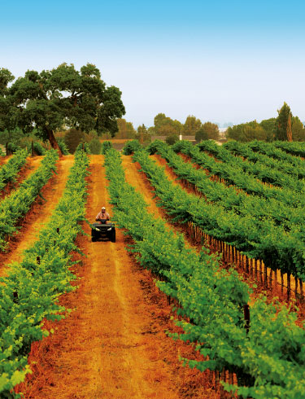
DIVERSE
Landscape
Climate
People
Wines
5,900 winegrape growers
110+ winegrape varieties
DiscoverCaliforniaWines.com
Notes:
California vintners and growers are leaders in combining tradition and innovation.
Our 5,900 growers work with a diverse landscape, varied climate, and more than 110 winegrape varieties. Our talented growers and vintners have all the natural ingredients to make outstanding wines.
Our multi-generational families, many originally from Italy, Germany and France, have set deep roots in California, and the state continues to attract talent from around the world.

Slide 5
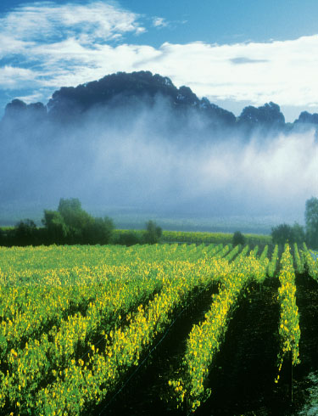
Geography + climate + soil = ideal conditions for quality grapes
602,000 acres (244,000 hectares) of winegrapes
4.0 million tons (almost 3.6 billion kilograms) of winegrapes harvested in 2016
DiscoverCaliforniaWines.com
Notes:
The geography, climate and soil in California create ideal conditions for quality winegrapes
There are 602,000 acres (246,000 hectares) of winegrapes grown in California
California harvested 4.0 million tons (almost 3.4 billion kilograms) of winegrapes in 2016
Winegrapes are a top crop, but vineyards only cover about one percent of California’s vast terrain.

Slide 6
Hundreds of diverse microclimates
138 distinct AVAs (American Viticultural Areas)
90% of US wine exports come from California
California wines are sold in 138 countries
DiscoverCaliforniaWines.com
Notes:
California has hundreds of diverse microclimates
There are 138 distinct AVAs (American Viticultural Areas)
90% of US wine exports come from California
California wines are sold in 138 countries

Slide 7
/ CALIFORNIA GEOGRAPHY
DiscoverCaliforniaWines.com
Notes:
California’s geography is diverse with mountains, valleys, coast, desert and high elevations.
Our coastal mountain ranges help protect California’s winegrowing regions and ensure consistent growing conditions year after year.
The diverse geography that is so great for grapes is also great for outdoor recreation: relaxed beach lifestyle, dramatic desert landscapes, spectacular mountains for skiing, hiking and camping.

Slide 8
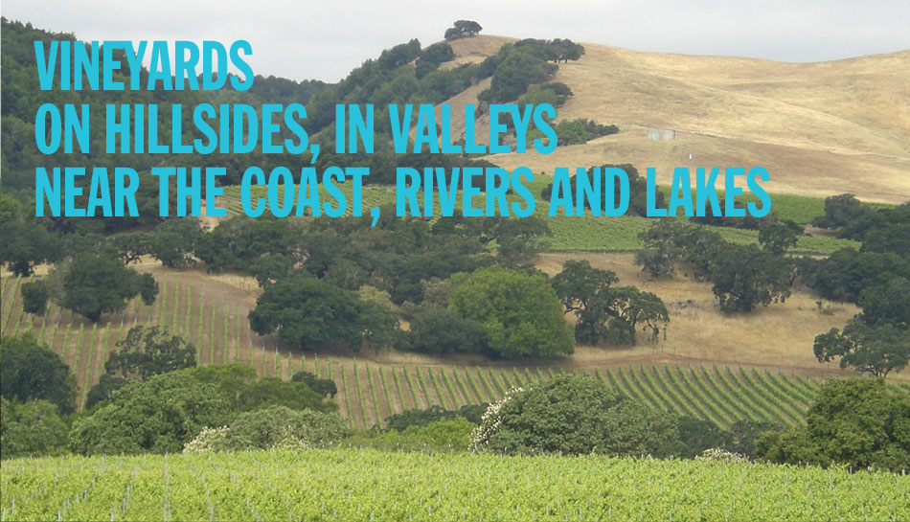
/ CALIFORNIA GEOGRAPHY
138 American Viticultural Areas (AVAs)
DiscoverCaliforniaWines.com
Notes:
Vineyards thrive on hillsides, in valleys, near the coast, rivers and lakes.
California has 138 American Viticultural Areas (AVAs), U.S. government approved winegrowing areas. AVAs have unique geographical features, climate and history.

Slide 9
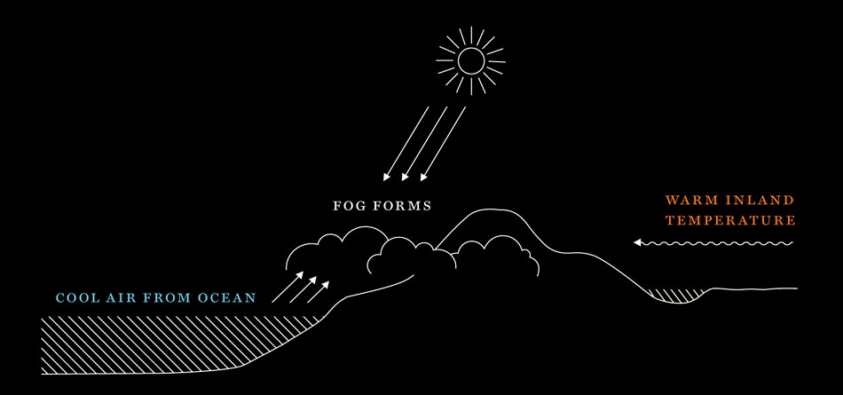
/ CALIFORNIA CLIMATE
Unparalleled scenic beauty
Warm days, cool nights
Ideal conditions for winegrape growing
Warm days ripen the grapes, cool nights regulate the fruit maturation
DiscoverCaliforniaWines.com
Notes:
This slide illustrates how the cool air from the ocean intersects with warm inland air to create California’s signature fog.
California’s warm days and cool nights are the ideal conditions for winegrape growing. Warm days ripen the grapes and cool nights regulate the fruit maturation.

Slide 10
/ CALIFORNIA CLIMATE
Unparalleled scenic beauty
Cool Ocean Air →
Warm Inland Air ←
Click to play animation
As a result of California’s long coastline & varied topography:
- Abundant sunshine + maritime influence
- Hot + Cold air create fog
DiscoverCaliforniaWines.com
Notes:
As a result of California’s long coastline and varied topography, we have abundant sunshine and maritime influence. Warm inland air, represented by the orange shape, and cool coastal air, represented by the blue shape meet and create fog.
California enjoys an ideally long, consistent and dry growing season, which generally starts with bud break in March and concludes with harvest, which can last through November.
**(Play animation in slide above)**

Slide 11
/ CALIFORNIA SOILS
Unparalleled scenic beauty
The formation of California created a large diversity of 2,800 soil types, among them:
Sand
Clay
Loam
Granite
Volcanic ash
Seabed soil
River-run gravel
Click to play animation
DiscoverCaliforniaWines.com
Notes:
The geological formation of California created a large diversity of soil types, among them sand, clay, loam, granite, volcanic ash, seabed soil, and river-bed gravel
There are more than 2,800 soil types in California

Slide 12
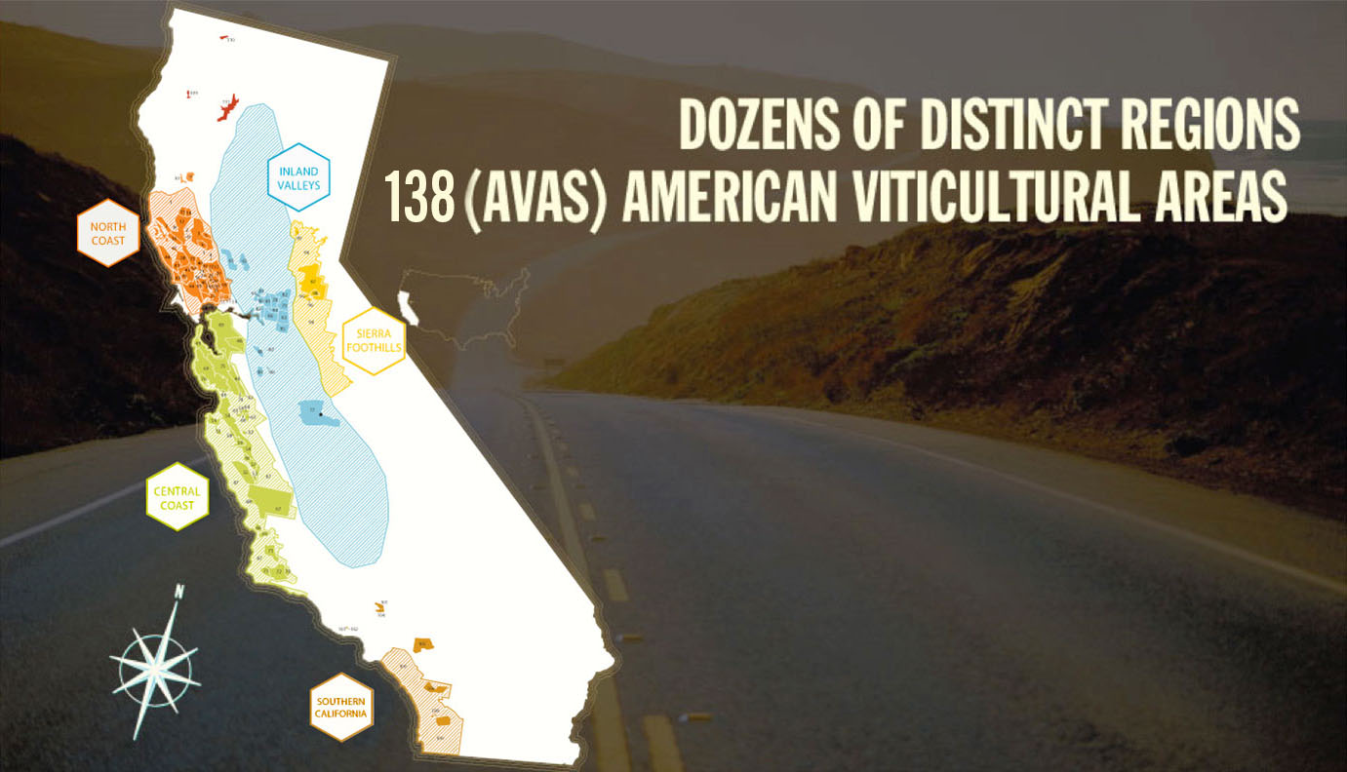
Unparalleled scenic beauty
What is an AVA?
American Viticultural Area:
A U.S. government recognized
winegrowing region
DiscoverCaliforniaWines.com
Notes:
There are dozens of distinct winegrowing regions in California, with 138 AVAs, which are U.S. government recognized winegrowing regions.
Wine labels can show either an AVA or the name of a county or state as the appellation.

Slide 13
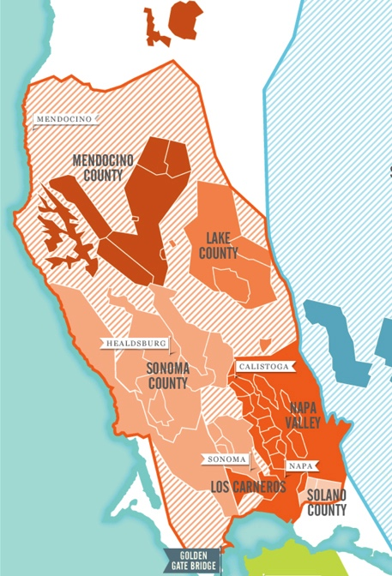
/ NORTH COAST
North Coast (54 AVAs)
One of the coolest climates in the state
Home to more than half of California’s wineries
The scenery along the North Coast is as memorable as the wine
DiscoverCaliforniaWines.com
Notes:
Some of the North Coast’s best known regions include: Lake County, Los Carneros, Mendocino County, Napa Valley and Sonoma County
California’s North Coast has 54 AVAs.
It is home to more than half of California’s wineries
The scenery along the North Coast is as memorable as the wine, with beaches, dramatic seaside cliffs, towering redwoods, and rolling hills dotted with oak trees which are all part of the scenic pastoral landscape.

Slide 14
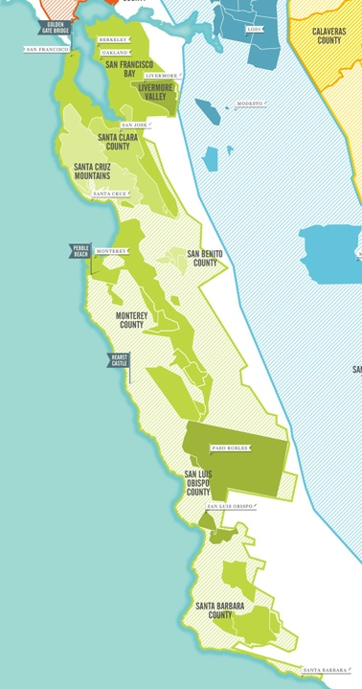
/ CENTRAL COAST
Central Coast (43 AVAs) and
Santa Cruz Mountains (1 AVA)
Weather transitions from cool coastal to warmer inland areas
One of the fastest growing wine regions in the state
Grapes have been cultivated here since the 1700s
DiscoverCaliforniaWines.com
Notes:
Some of the Central Coast’s best known regions include: Livermore Valley, Monterey County, Paso Robles, San Benito County, San Francisco Bay, San Luis Obispo County, Santa Barbara County and Santa Clara County. Santa Cruz Mountains is located adjacent to the Central Coast.
California’s Central Coast has 43 AVAs and also surrounds the Santa Cruz Mountains AVA
It is one of the fastest growing wine regions in the state, with about 350 wineries in San Luis Obispo/Paso Robles alone.
Grapes have been cultivated here since the 1700s.
This region is gaining more recognition as more wineries are established here.

Slide 15
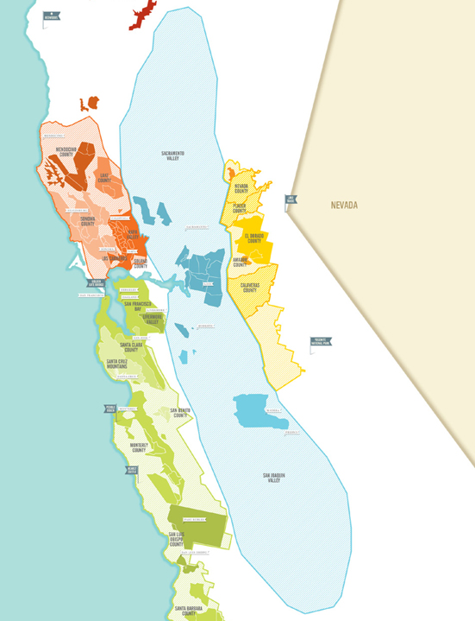
/ INLAND VALLEYS
Inland Valleys (18 AVAs)
One of the most fertile farmlands in the world, California’s sunny inland valleys are great for grapes and hundreds of other agricultural crops
DiscoverCaliforniaWines.com
Notes:
Some of the Inland Valleys’ best know regions include: Lodi & the Delta, Madera County, Sacramento Valley and San Joaquin Valley
California’s Inland Valleys have 18 AVAs. It comprises two valleys--San Joaquin Valley and Sacramento Valley. This vast region stretches from Redding in the north to Bakersfield in the south.
One of the most fertile farmlands in the world, California’s sunny inland valleys are great for grapes and 400 agricultural crops. This area grows 40% of America’s fruits, vegetables and other crops.
This area is home to prominent academic institutions with world class programs for viticulture and enology – the University of California at Davis and Fresno State University.

Slide 16
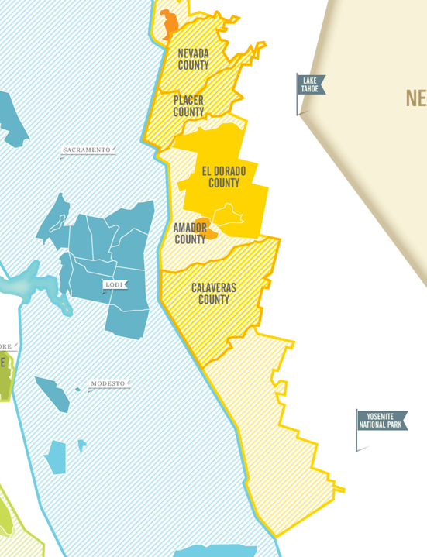
/ SIERRA FOOTHILLS
Sierra Foothills (6 AVAs)
The epicenter of the California Gold Rush, immigrants who sought fortune in the mines here left their vines in the soil
Now, a vibrant region for winegrapes and touring
DiscoverCaliforniaWines.com
Notes:
Some of the Sierra Foothills’ best known regions include: Amador County, El Dorado County, Nevada County and Placer County
California’s Sierra Foothills region has 6 AVAs.
This area became the epicenter of the California Gold Rush.
Gold was first discovered near Sacramento in 1848. The Gold Rush of 1849 caused California’s population to soar by a half a million, from an estimated 14,000 (exclusive of Native Americans), making it one of the largest migrations of people in history. For many, “gold fever” became “vine fever” as news of winegrower profits spread and vineyard trials showed that California’s sunshine allowed grapes to ripen fully nearly everywhere in the state.
Known for Zinfandels, the area is now a vibrant region for winegrapes and touring. The area is home to Yosemite National Park and Lake Tahoe.

Slide 17
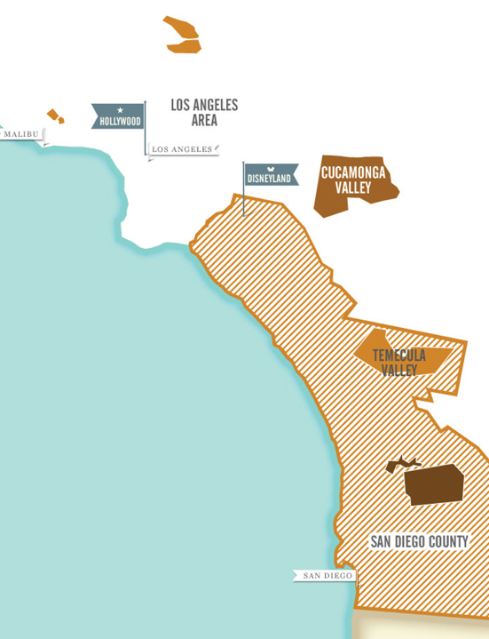
/ SOUTHERN CALIFORNIA
Southern California (11 AVAs)
Southern California celebrities share the blue skies, sunshine and famous beaches with quiet vineyards tucked into rolling valleys and foothills
DiscoverCaliforniaWines.com
Notes:
Some of Southern California’s best known regions include: Cucamonga Valley, Los Angeles Area, San Diego County and Temecula Valley
Southern California has 11 AVAs, including the new Malibu Coast AVA.
Here celebrities share the blue skies, sunshine and famous beaches with quiet vineyards tucked into rolling valleys and foothills.
Temecula Valley wineries, located south of the country’s largest wine market—Los Angeles—have become a destination for wine lovers. Many wineries offer not only tasting, but restaurants, live music and accommodations. Other wine areas in Southern California include Ventura, Malibu, Cucamonga Valley and San Diego.

Slide 18
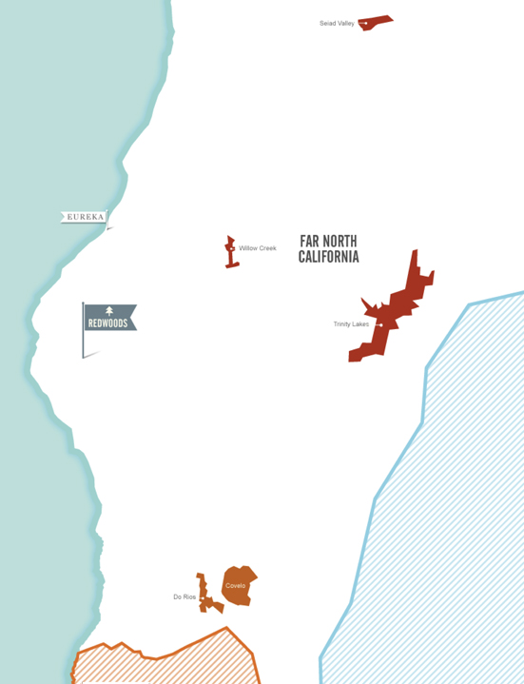
Far North California (5 AVAs)
This northernmost region is home to the “Lost Coast”
Humboldt, Siskiyou, Trinity, Shasta and Tehama counties offer diverse winegrowing areas and landscapes from redwood forest canyons to the Pacific Ocean
DiscoverCaliforniaWines.com
Notes:
This is the northernmost of California’s winegrowing regions, and is home to the “Lost Coast,” a remote and beautiful area of California’s coast, and the new Manton Valley AVA east of Redding.
Humboldt, Siskiyou, Trinity, Shasta and Tehama counties offer diverse winegrowing areas and landscapes from redwood forest canyons to the Pacific Ocean.

Slide 19
/ CALIFORNIA RED WINES
Barbera
Cabernet Franc
Cabernet Sauvignon
Grenache
Malbec
Merlot
Mourvédre
Petite Sirah
Pinot Noir
Red Blends
Sangiovese
Syrah
Tempranillo
Zinfandel
DiscoverCaliforniaWines.com
Notes:
Here is a list of the top red wine varietals grown in California – (this is alphabetical order and not based on acreage or wine production)
Cabernet Sauvignon is the top-selling red wine, followed by Merlot and Pinot Noir.
California’s signature varietal is Zinfandel because of its unique history here.

Slide 20
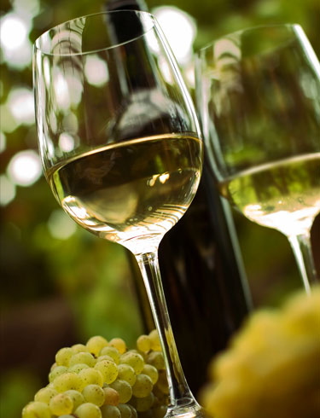
/ CALIFORNIA WHITE WINES
Chardonnay
Chenin Blanc
Gewurztraminer
Grenache Blanc
Marsanne
Moscato/Muscat
Pinot Blanc
Pinot Grigio
Riesling
Rousanne
Sauvignon Blanc
Semillon
Viognier
White Blends
DiscoverCaliforniaWines.com
Notes:
Here is a list of the main white wine varietals grown in California – (this is alphabetical order and not based on acreage or wine production)
Chardonnay is the top selling white wine, followed by Pinot Grigio and Sauvignon Blanc. Moscato and Riesling show strong growth in acreage.

Slide 21
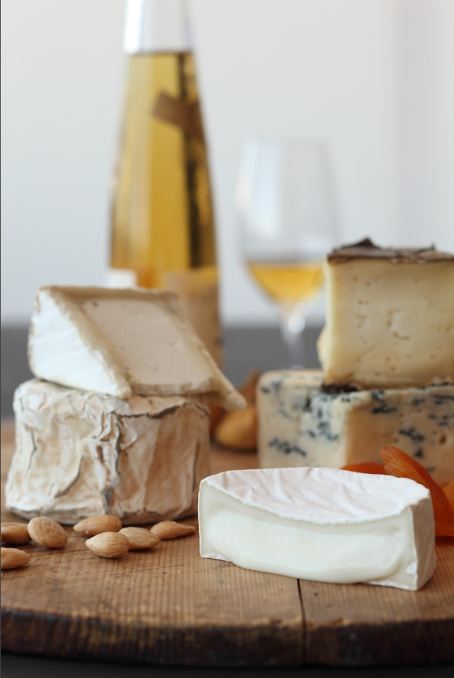
/ ROSÉ, SPARKLING AND DESSERT WINES
California Rosé Wines
The red berry flavors of rosé are especially refreshing on cool autumn evenings and hot summer days
California Sparkling Wines
The crisp acidity of California sparkling wine pairs well with a wide range of foods and occasions
California Dessert Wines
Also called late harvest wines, these deep elixirs provide a sweet end to any meal
DiscoverCaliforniaWines.com
Notes:
California Rosé Wines: The red berry flavors of rosé are especially refreshing on cool autumn evenings and hot summer days
California Sparkling Wines: The crisp acidity of California sparkling wine pairs well with a wide range of foods and occasions
California Dessert Wines: Also called late harvest wines, these deep elixirs provide a sweet end to any meal
These wines range from very dry to sweet and pair well with a variety of food

Slide 22
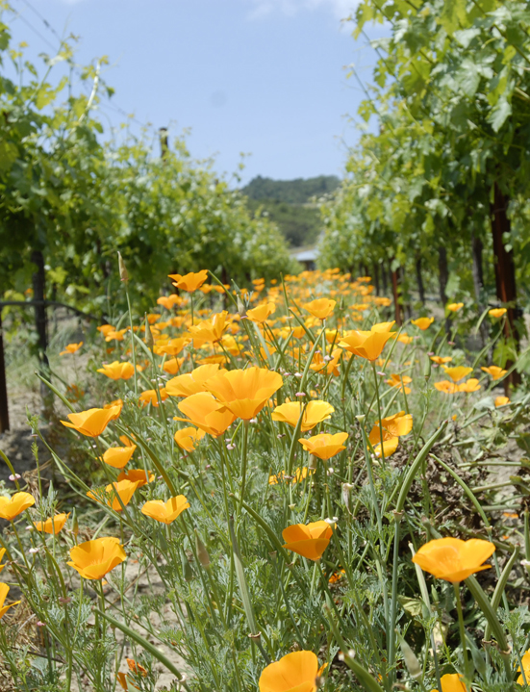
California has some of the strongest environmental and labor laws and regulations in the world
California vintners and growers have long been environmental stewards and active members of their communities
California wineries and vineyards are primarily family owned with a commitment to preserving the health and beauty of the land for future generations
DiscoverCaliforniaWines.com
Notes:
California is the most populous state in the U.S. and is growing every year. As a result, there is competition for land, water, energy and other limited natural resources.
The California wine community established the Code of Sustainable Winegrowing program to use resources wisely, and to pass healthy, sustainable businesses to family and the next generation.
Some background about California and its wine industry includes:
California has some of the strongest environmental and labor laws and regulations in the world
California vintners and growers have long been environmental stewards and active members of their communities
California wineries and vineyards are primarily family owned with a commitment to preserving the health and beauty of the land for future generations

Slide 23
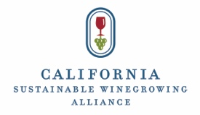
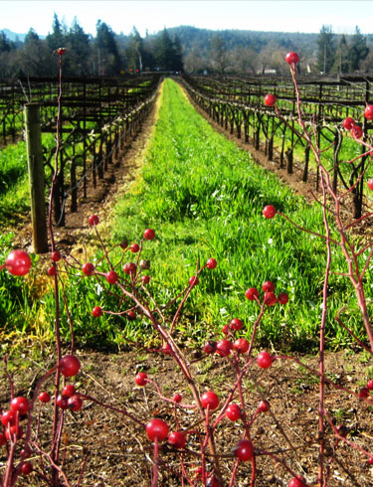
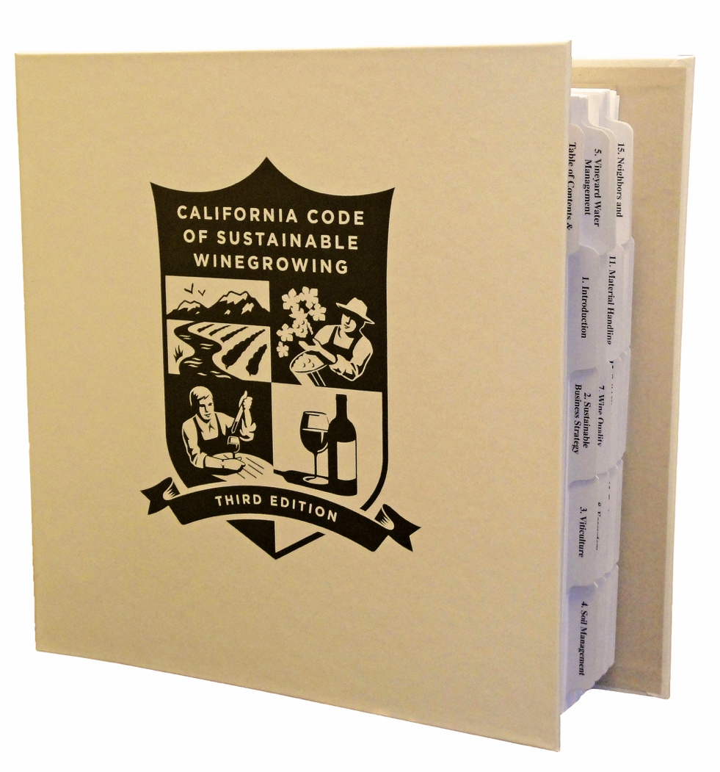
/ CALIFORNIA CODE OF SUSTAINABLE WINEGROWING
A Code to Live By
Wine Institute and the California Association of Winegrape Growers introduced the Code of Sustainable Winegrowing in 2002
Covers more than 200 best sustainable practices
2,100 wineries and vineyards representing 75% of vineyard acres and 80% of winery case production are participating in the California Sustainable Winegrowing Program, which is based on the Code.
DiscoverCaliforniaWines.com
Notes:
The program is over a decade old and is one of the most widely adopted sustainable winegrowing programs in the world.
The program includes 200 sustainable practices from grape to glass.
2,100 wineries and vineyards representing 769% of vineyard acres and 79% of winery case production are participating in the California Sustainable Winegrowing Program, which is based on the Code.

Slide 24
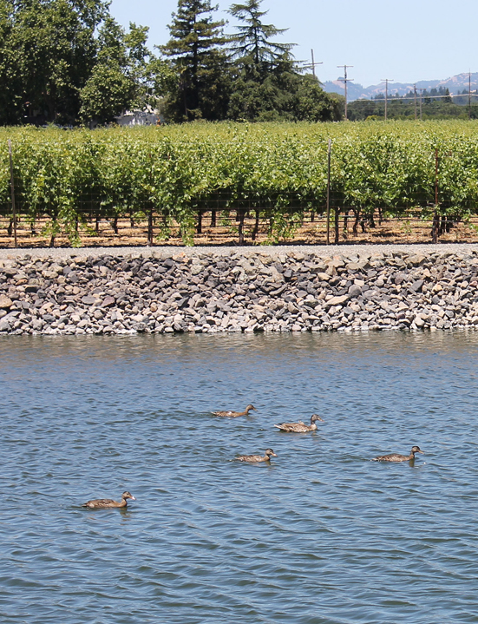
/ PRACTICES IN VINEYARDS & WINERIES
Managing vineyards for sustainability and quality fruit
Conserving water and energy
Protecting air and water quality
Maintaining healthy soil
Reducing pesticide use
Preserving local ecosystems and wildlife habitats
Recycling natural resources
Practicing environmentally preferred purchasing
Enhancing relations with employees and communities
DiscoverCaliforniaWines.com
Notes:
There are over 200 practices in the Code of Sustainable Winegrowing that encompass activities in vineyards & wineries, employees, community relations, and here are some examples:
Managing vineyards for sustainability and quality fruit
Conserving water and energy
Protecting air and water quality
Maintaining healthy soil
Reducing pesticide use
Preserving local ecosystems and wildlife habitats
Recycling natural resources
Practicing environmentally preferred purchasing
Enhancing relations with employees and communities

Slide 25
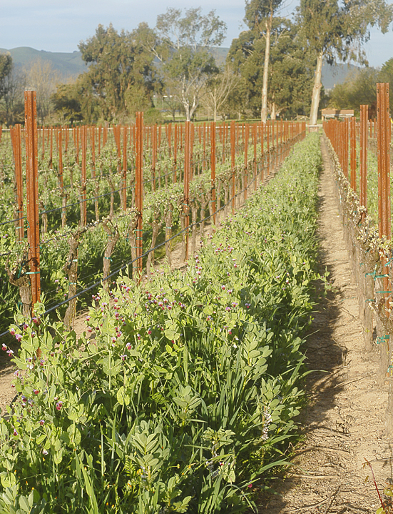
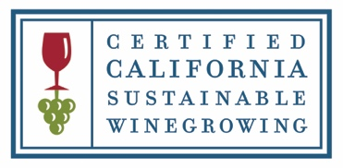
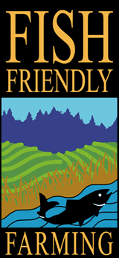
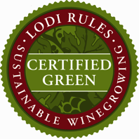
/ CERTIFIED CALIFORNIA SUSTAINABLE WINEGROWING
Certified California Sustainable Winegrowing (CCSW)
Based on the California Code of Sustainable Winegrowing, CCSW provides third-party verification of the adoption of practices and progress towards goals
California certification programs:
DiscoverCaliforniaWines.com
Notes:
Introduced in 2010, certification based on the California Code of Sustainable Winegrowing provides 3rd-party verification of the adoption of practices by a vineyard or winery and their progress in continuous improvement.
In addition to an annual assessment, certification requires meeting 50 vineyard and 32 winery standards.
In addition to Certified California Sustainable Winegrowing (CCSW) there are a number of other programs active in the state that offer regional or statewide certification.
These include: Lodi Rules, SIP-Certified, Fish Friendly Farming, Napa Green Winery and Land certifications and the Bay Area Green Business Program.
All of these California programs play an important role in the ever-expanding tapestry of the California wine community’s efforts to produce high quality wine that is environmentally sound, economically feasible and socially equitable.

Slide 26
Unparalleled scenic beauty
California cuisine is fusion at its finest and most flavorful
California wines pair extremely well with a vast array of food – from fresh California cuisine to the best local specialties from around the world
DiscoverCaliforniaWines.com
Notes:
There are many ethnic influences in California cuisine, from the Italians, Germans and Irish to Asians and Latinos of the present day. California wines pair well with a variety of foods, from fresh California cuisine to the best local specialties from around the world.
The diversity of winegrowing regions in California, with 135 AVAs, creates differences in wine styles even within the same varietal.
California grows more than 110 different winegrape varieties. Cabernet Sauvignon is the most popular red grape and Chardonnay is the most popular white grape. Zinfandel is California’s heritage grape. Blends are a growing trend among California wineries, as are aromatic whites like Moscato and Pinot Grigio.
The availability of more than 400 local farm crops and the diversity of ethnic cultures in California have inspired chefs to create a vast array of new and fresh dishes here, all paired with local California wines.
Visitors enjoy the more than 60,000 eating and drinking places in California.

Slide 27
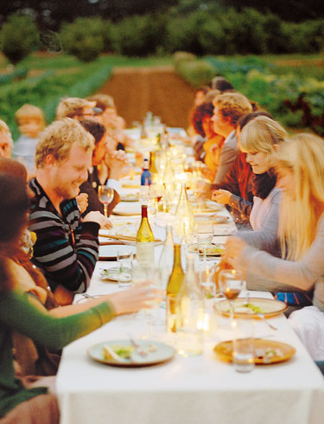
Growing Around the World
California is the fourth largest wine producer in the world (after France, Italy, Spain)
California wine exports set a record in 2016, reaching 1.62 billion in winery revenues
California wine sales in the U.S., the world’s largest wine market, have grown over the last 22 years
DiscoverCaliforniaWines.com
Notes:
California wines are growing around the world
California is the fourth largest wine producer in the world (after France, Spain, Italy)
California wine exports set a record in 2015, reaching 1.6 billion in winery revenues
California wine sales in the U.S., the world’s largest wine market, have grown over the last 21 years

Slide 28
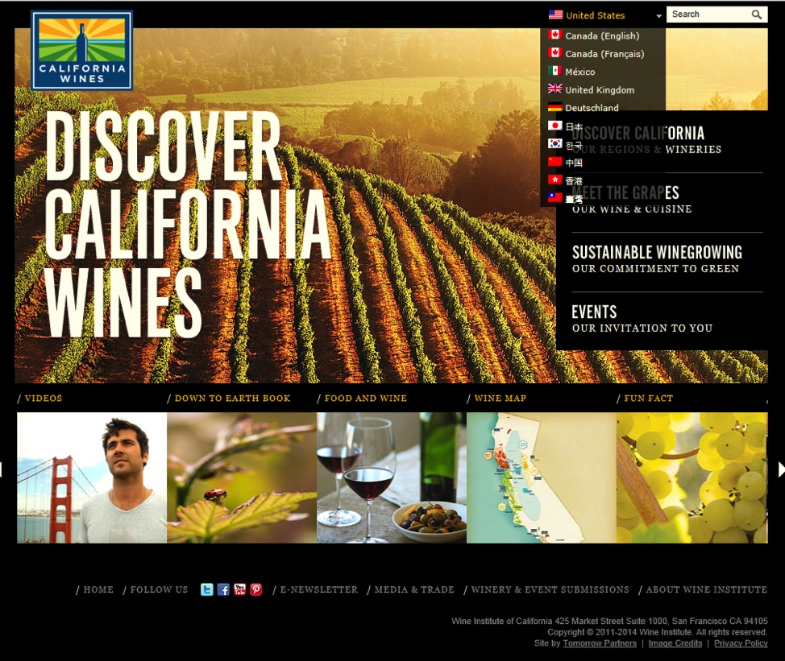
Canada (English & Quebec/French)
www.DiscoverCaliforniaWines.CA
China
www.DiscoverCaliforniaWines.com.CN
Germany
www.DiscoverCaliforniaWines.DE
Hong Kong
www.DiscoverCaliforniaWines.HK
Japan
www.DiscoverCaliforniaWines.JP
Mexico
www.DiscoverCaliforniaWines.com.MX –
South Korea
www.DiscoverCaliforniaWines.KR
Taiwan
www.DiscoverCaliforniaWines.TW
United Kingdom
www.DiscoverCaliforniaWines.CO.UK
Visit Us:
DiscoverCaliforniaWines.com
Notes:
More than 21 million visitors come to California wine regions each year.
www.Discovercaliforniawines.com was created to help consumers find direct links to California wineries, winery events and all things California wine.
The website is available in English and in foreign-language versions for the following countries: China, Germany, Hong Kong, Japan, Mexico, Quebec, South Korea, Taiwan.

